Slide 1
Clase 15
Juan Manuel Cabezas Contardo
Computación Numérica
jcabezasc@ucm.cl

Slide 2
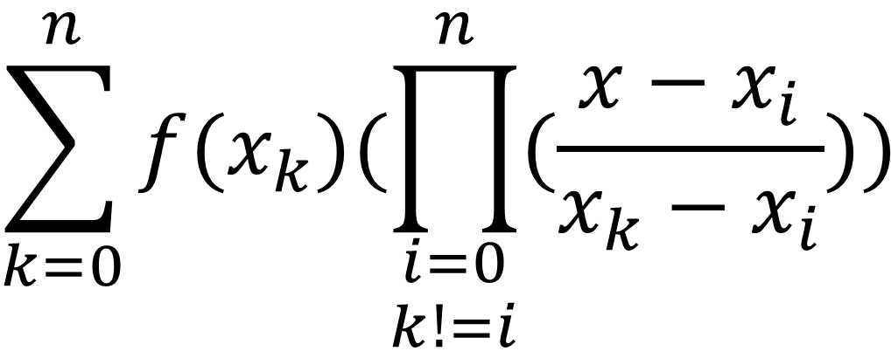
Interpolación de Langrange
$$\sum_{k=0}^{n}{f(x_{k})(\prod_{\begin{aligned}i=0 \\ k!=i\end{aligned}}^{n}{(\frac{x−x_{i}}{x_{k}−x_{i}})})}$$

Slide 3

Ejercicio
$f\left(x\right)=x+1$
x | f(x)
0 | 1
2 | 3
4 | 5

Slide 4
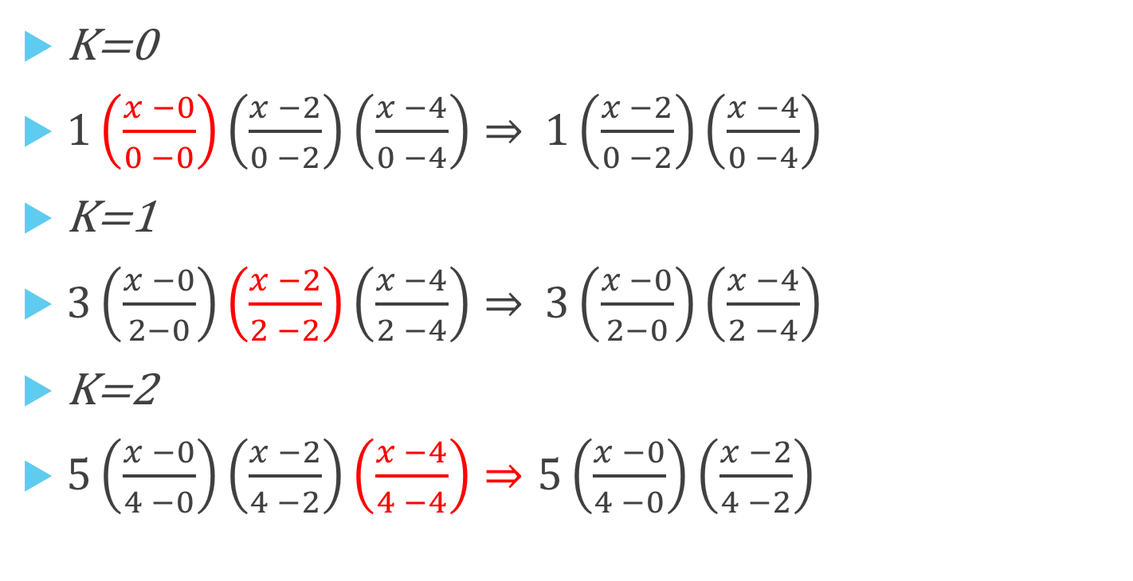
K=0
$1\left(\frac{x −0}{0 −0}\right)\left(\frac{x −2}{0 −2}\right)\left(\frac{x −4}{0 −4}\right)⇒$ $1\left(\frac{x −2}{0 −2}\right)\left(\frac{x −4}{0 −4}\right)$
K=1
$3\left(\frac{x −0}{2−0}\right)\left(\frac{x −2}{2 −2}\right)\left(\frac{x −4}{2 −4}\right)⇒$ $3\left(\frac{x −0}{2−0}\right)\left(\frac{x −4}{2 −4}\right)$
K=2
$5\left(\frac{x −0}{4 −0}\right)\left(\frac{x −2}{4 −2}\right)\left(\frac{x −4}{4 −4}\right)⇒5\left(\frac{x −0}{4 −0}\right)\left(\frac{x −2}{4 −2}\right)$
x | f(x)
0 | 1
2 | 3
4 | 5

Slide 5
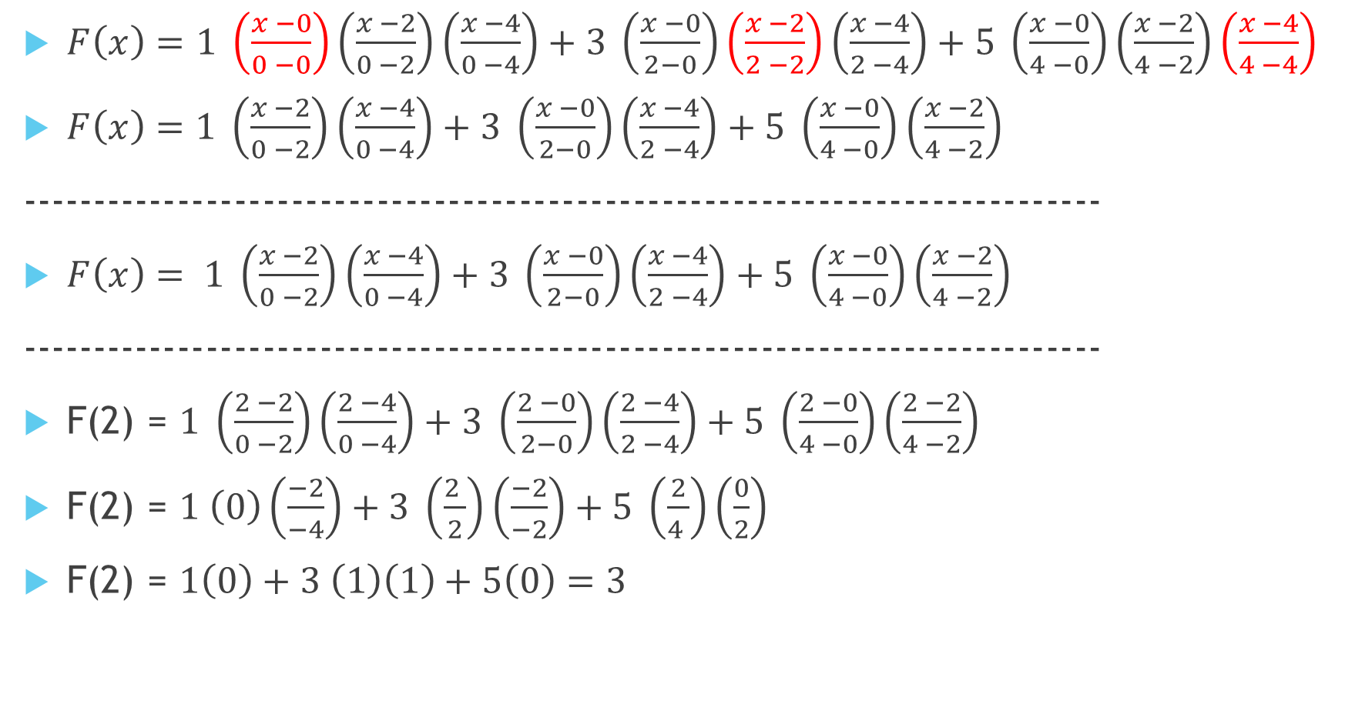
$F\left(x\right)=$ $1 \left(\frac{x −0}{0 −0}\right)\left(\frac{x −2}{0 −2}\right)\left(\frac{x −4}{0 −4}\right)+3 \left(\frac{x −0}{2−0}\right)\left(\frac{x −2}{2 −2}\right)\left(\frac{x −4}{2 −4}\right)+5 \left(\frac{x −0}{4 −0}\right)\left(\frac{x −2}{4 −2}\right)\left(\frac{x −4}{4 −4}\right)$
$F\left(x\right)=1 \left(\frac{x −2}{0 −2}\right)\left(\frac{x −4}{0 −4}\right)+3 \left(\frac{x −0}{2−0}\right)\left(\frac{x −4}{2 −4}\right)+5 \left(\frac{x −0}{4 −0}\right)\left(\frac{x −2}{4 −2}\right)$
----------------------------------------------------------------------------
$F\left(x\right)= 1 \left(\frac{x −2}{0 −2}\right)\left(\frac{x −4}{0 −4}\right)+3 \left(\frac{x −0}{2−0}\right)\left(\frac{x −4}{2 −4}\right)+5 \left(\frac{x −0}{4 −0}\right)\left(\frac{x −2}{4 −2}\right)$
----------------------------------------------------------------------------
F(2) = $1 \left(\frac{2 −2}{0 −2}\right)\left(\frac{2 −4}{0 −4}\right)+3 \left(\frac{2 −0}{2−0}\right)\left(\frac{2 −4}{2 −4}\right)+5 \left(\frac{2 −0}{4 −0}\right)\left(\frac{2 −2}{4 −2}\right)$
F(2) = $1 \left(0\right)\left(\frac{−2}{−4}\right)+3 \left(\frac{2 }{2}\right)\left(\frac{−2}{−2}\right)+5 \left(\frac{2}{4 }\right)\left(\frac{0}{2}\right)$
F(2) = $1\left(0\right)+3 \left(1\right)\left(1\right)+5\left(0\right)=3$

Slide 6
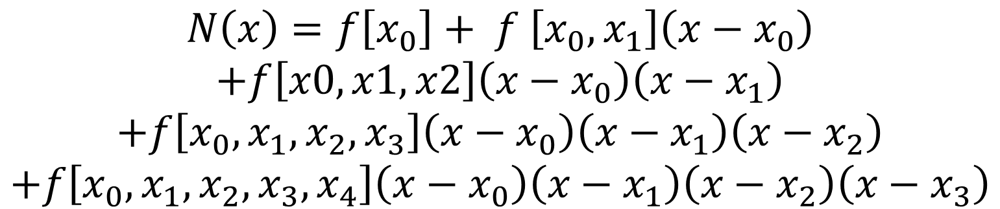
Interpolación de Newton
$$N\left(x\right)=f\left[x_{0}\right]+ f \left[x_{0},x_{1}\right]\left(x−x_{0}\right)$$
$$+f\left[x0,x1,x2\right]\left(x−x_{0}\right)\left(x−x_{1}\right)$$
$$+f\left[x_{0},x_{1},x_{2},x_{3}\right]\left(x−x_{0}\right)\left(x−x_{1}\right)\left(x−x_{2}\right)$$
$$+f\left[x_{0},x_{1},x_{2},x_{3},x_{4}\right]\left(x−x_{0}\right)\left(x−x_{1}\right)\left(x−x_{2}\right)\left(x−x_{3}\right)$$

Slide 7
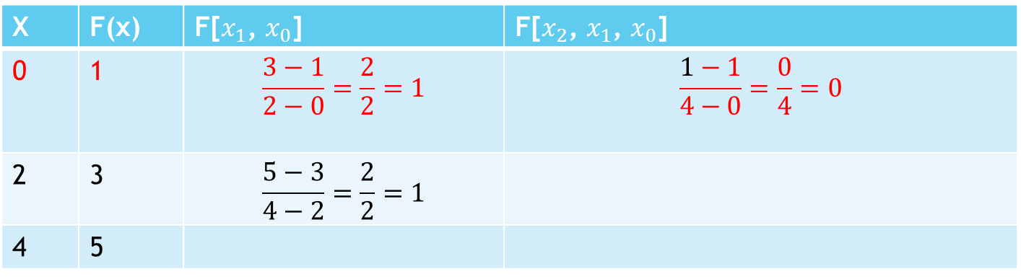
Ejercicio 1
X | F(x) | F[$x_{1}$, $x_{0}$] | F[$x_{2}$, $x_{1}$, $x_{0}$]
0 | 1 | $$\frac{3−1}{2−0}=\frac{2}{2}=1$$ | $$\frac{1−1}{4−0}=\frac{0}{4}=0$$
2 | 3 | $$\frac{5−3}{4−2}=\frac{2}{2}=1$$
4 | 5
$$N\left(x\right)=f\left[x_{0}\right]+ f \left[x_{0},x_{1}\right]\left(x−x_{0}\right)+f\left[x0,x1,x2\right]\left(x−x_{0}\right)\left(x−x_{1}\right)$$
$$N\left(x\right)=1+1\left(x−0\right)+0\left(x−0\right)\left(x−2\right)$$
$$N\left(x\right)=1+x$$

Slide 8
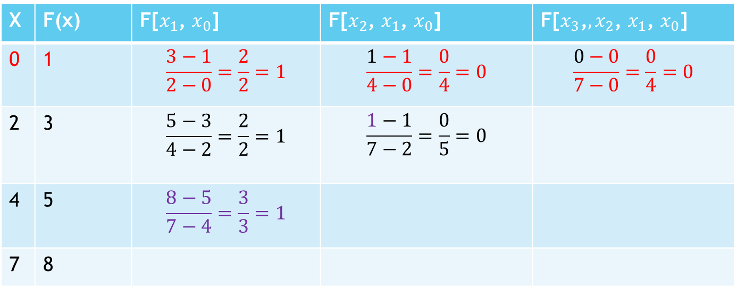
X | F(x) | F[$x_{1}$, $x_{0}$] | F[$x_{2}$, $x_{1}$, $x_{0}$] | F[$x_{3}\text{,},x_{2}$, $x_{1}$, $x_{0}$]
0 | 1 | $$\frac{3−1}{2−0}=\frac{2}{2}=1$$ | $$\frac{1−1}{4−0}=\frac{0}{4}=0$$ | $$\frac{0−0}{7−0}=\frac{0}{4}=0$$
2 | 3 | $$\frac{5−3}{4−2}=\frac{2}{2}=1$$ | $$\frac{1−1}{7−2}=\frac{0}{5}=0$$
4 | 5 | $$\frac{8−5}{7−4}=\frac{3}{3}=1$$
7 | 8
$$N\left(x\right)=f\left[x_{0}\right]+ f \left[x_{0},x_{1}\right]\left(x−x_{0}\right)+f\left[x0,x1,x2\right]\left(x−x_{0}\right)\left(x−x_{1}\right)+f\left[x_{0},x_{1},x_{2},x_{3}\right]\left(x−x_{0}\right)\left(x−x_{1}\right)\left(x−x_{2}\right)$$
$$N\left(x\right)=1+1\left(x−0\right)+0\left(x−0\right)\left(x−2\right)+0\left(x−0\right)\left(x−2\right)\left(x−4\right)$$
$$N\left(x\right)=1+x$$

